Slide 1
Digital Twin
Akhi Azim Papri
Roll : 2112276104
RU-CSE.
Digital Twin

Slide 2


Unveiling the Potential: A Comprehensive Exploration of Digital Twin.
Digital Twin

Slide 3

Index
Introduction
Key Components
Application in Industry
Advantages and Impact
Challenges and Solution
Future Trends
Ethical Considerations
Future Prospects
Conclusion
Digital Twin

Slide 4

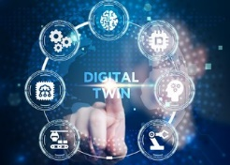

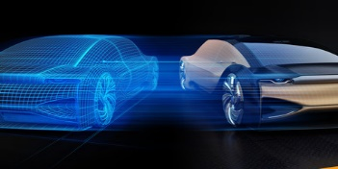
Introduction
The virtual representation or digital replica of a physical object, system, or process. Real-time synchronization with physical counterparts.
Digital Twin

Slide 5


Key Components
Physical Entity
Sensors and Data Acquisition
IOT Connectivity
Communication Protocols
Data Storage and Management
Simulation and Modeling
Analytics and Artificial Intelligence
User Interface and Visualization
Lifecycle Management
Security Measures
Digital Twin

Slide 6


Applications in Industry
Manufacturing
Healthcare
Aerospace
Automotive
Smart Cities
Oil and Gas
Digital Twin

Slide 7
Advantages and Impact
Optimized Performance
Improved Decision-Making
Energy Efficiency
Cost Savings
Remote Monitoring and Control
Digital Twin

Slide 8


Challenges
Data Security and Privacy
Interoperability
Integration with Legacy Systems
Data Quality and Accuracy
Skill Gaps and Training
Solutions
Standardization
Advanced encryption
Robust connectivity protocols.
Digital Twin

Slide 9

Future Trends
Enhanced AI integration
Autonomous decision-making
Blockchain for Data Security
Real-world case studies demonstrating the eﬀectiveness of digital twins in optimizing operations, improving productivity, and enabling predictive insights.
Digital Twin

Slide 10


Ethical Considerations
The main ethical considerations in digital twins include :
Data privacy and data ownership
Potential biases in AI algorithms
Environmental impact
Risks of employment displacement.
.
Digital Twin

Slide 11

Future Prospects
Exploring the future prospects of digital twins: evolution into holistic digital representations, integration with AR/VR, and potential societal impact.
Digital Twin

Slide 12
Conclusion
Digital twins oﬀer a transformative approach to
enhancing operations and decision-making. Embrace the potential of digital twins for
innovation and sustainable growth.
Digital Twin

Slide 13

Do you have any questions?
Digital Twin

Slide 14



Thanks!
Akhi Azim Papri
s2112276104@ru.ac.bd
Digital Twin

